Slide 1

UNIVERSITY INSTITUTE OF ENGINEERING
COMPUTER SCIENCE ENGINEERING
Bachelor of Engineering
Design and Analysis of Algorithms(CST-302/ITT-302)
Er. Amrita Chaudhary (E8745)
Topic: Introduction to Graphs & Graph Traversals
DISCOVER . LEARN . EMPOWER

Slide 2
Learning Objectives & Outcomes
Objective:
To understand meaning and representation of graphs
Outcome:
Student will understand the meaning of graphs and its algorithms.

Slide 3
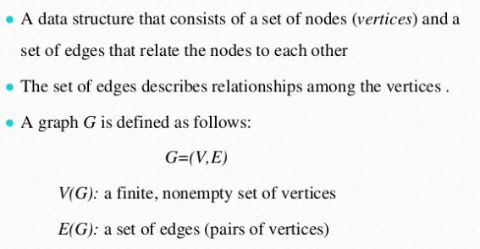
GRAPHS

Slide 4
Graph Data Structure
Vertex − Each node of the graph is represented as a vertex. In the following example, the labeled circle represents vertices
Edge − Edge represents a path between two vertices or a line between two vertices.
Adjacency − Two node or vertices are adjacent if they are connected to each other through an edge.
Path − Path represents a sequence of edges between the two vertices. In the following example, ABCD represents a path from A to D.

Slide 5
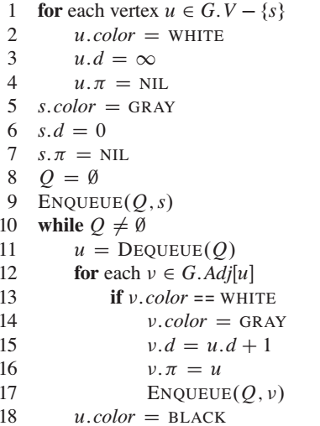
BFS

Slide 6
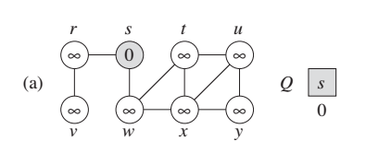
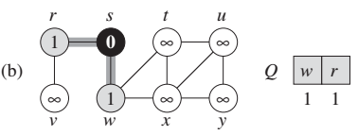
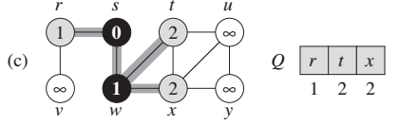

Slide 7
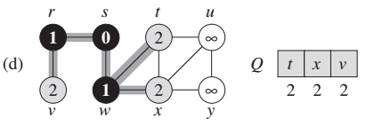
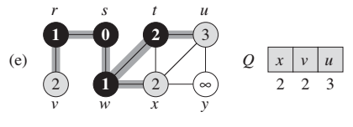
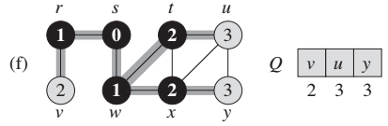

Slide 8
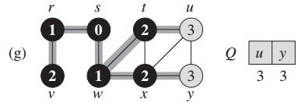
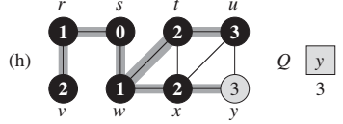
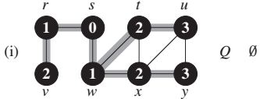

Slide 9
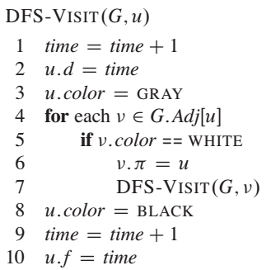
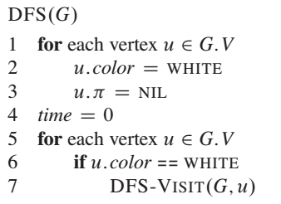
DFS
Depth First Search (DFS) algorithm traverses a graph in a depth ward motion and uses a stack to remember to get the next vertex to start a search, when a dead end occurs in any iteration.

Slide 10
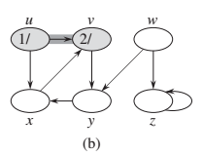
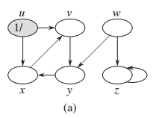
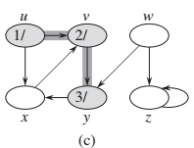
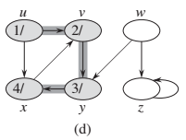

Slide 11
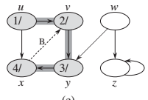
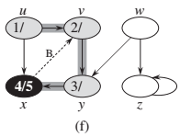
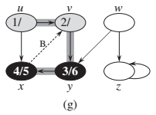
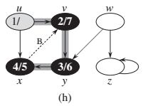

Slide 12
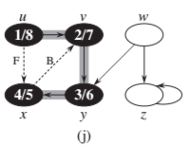
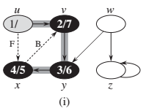
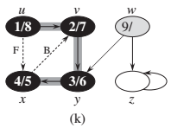
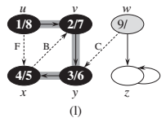

Slide 13
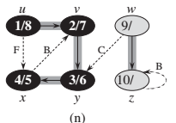
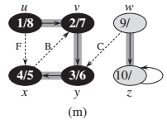
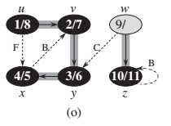
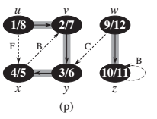

Slide 14
Topological Sort
Topological Sort is a linear ordering of the vertices in such a way that if there is an edge in the DAG going from vertex ‘u’ to vertex ‘v’, then ‘u’ comes before ‘v’ in the ordering.
Topological Sorting is possible if and only if the graph is a Directed Acyclic Graph.
There may exist multiple different topological orderings for a given directed acyclic graph.

Slide 15
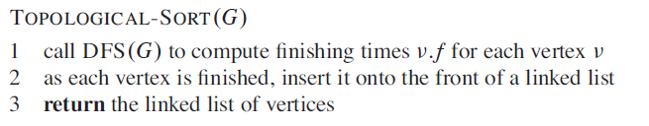
Algorithm

Slide 16
REFERENCES
Text books:
Cormen, Leiserson, Rivest, Stein, “Introduction to Algorithms”, Prentice Hall of India, 3rd edition 2012. problem, Graph coloring.
Websites:
https://www.tutorialspoint.com/data_structures_algorithms/graph_data_structure.htm
https://www.javatpoint.com/graph-theory-graph-representations
https://www.javatpoint.com/depth-first-search-algorithm
https://www.javatpoint.com/breadth-first-search-algorithm
https://www.gatevidyalay.com/topological-sort-topological-sorting/

Slide 17
THANK YOU

